Slide 1

Framer Motion
1 애니메이션 라이브러리

Slide 2
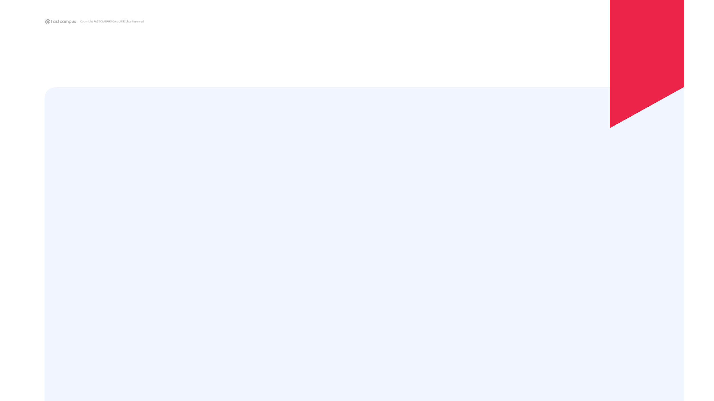
Framer
(https://www.framer.com/why-framer/)
Framer Motion
(https://www.framer.com/motion/)

Slide 3
Motion API
(https://www.framer.com/docs/introduction/)
Examples
(https://www.framer.com/docs/examples/)

Slide 4
Animation
(https://www.framer.com/docs/animation/)
Gestures
(https://www.framer.com/docs/gestures/)

Slide 5
Drag Example
(https://www.framer.com/docs/examples/#exit-animations)
MotionValue
(https://www.framer.com/docs/motionvalue/)
(https://www.framer.com/docs/examples/#motionvalues)

Slide 6
정리
Framer Motion
Framer
Design + Frontend Tool
Motion
Animation 기능이 들어간 Component
Variants
Propagation / Orchestration
Gestures / MotionValue
편의 기능들 제공

